Slide 1

The Human Body
CHAPTER 6

Slide 2
National EMS Education Standard Competencies (1 of 3)
Preparatory
Applies fundamental knowledge of the emergency medical services (EMS) system, safety/well-being of the emergency medical technician (EMT), medical/legal and ethical issues to the provision of emergency care.
Notes:
National EMS Education Standard Competencies
Preparatory
Applies fundamental knowledge of the emergency medical services (EMS) system, safety/well-being of the emergency medical technician (EMT), medical/legal, and ethical issues to the provision of emergency care.

Slide 3
National EMS Education Standard Competencies (2 of 3)
Anatomy and Physiology
Applies fundamental knowledge of the anatomy and function of all human systems to the practice of EMS.
Notes:
National EMS Education Standard Competencies
Anatomy and Physiology
Applies fundamental knowledge of the anatomy and function of all human systems to the practice of EMS.

Slide 4
National EMS Education Standard Competencies (3 of 3)
Pathophysiology
Applies fundamental knowledge of the pathophysiology of respiration and perfusion to patient assessment and management.
Notes:
National EMS Education Standard Competencies
Pathophysiology
Applies fundamental knowledge of the pathophysiology of respiration and perfusion to patient assessment and management.

Slide 5
Introduction
A working knowledge of anatomy is important.
Terminology:
  Anatomy
  Physiology
  Pathophysiology
Notes:
Lecture Outline
I. Introduction
A. A working knowledge of anatomy is important.
B. Terminology:
1. Anatomy: a field of study that focuses on the physical structure of the body and its systems.
2. Physiology: examines the normal functions and activities of the body and its systems.
3. Pathophysiology: the study of functional changes that accompany a particular disease or syndrome.

Slide 6
Topographic Anatomy
Topographic anatomy applies to a body in the anatomic position.
  Patient stands facing you, arms at side, palms forward.
Notes:
Lecture Outline
II. Topographic Anatomy
A. Topographic anatomy applies to the body in the anatomic position so that everyone is referring to the body in the same way.
1. Anatomic position: patient stands facing you, arms at side, palms forward

Slide 7
Planes of the Body (1 of 2)
Imaginary straight lines that divide the body
Three main areas
  Coronal (frontal) plane: divides the body front/back
  Sagittal (lateral) plane: divides the body left/right
  Midsagittal (midline) plane: divides the body into equal left and right halves
  Transverse (axial) plane: divides the body top/bottom
Notes:
Lecture Outline
C. Planes of the body
1. Imaginary straight lines that divide the body
2. Three main areas depending on how the body is divided:
a. Coronal (frontal plane: divides the body front and back
b. Sagittal (lateral) plane: divides the body left and right
c. Midsagittal plane (midline): a special type of sagittal plane where the body is cut in half, leaving equal left and right halves
d. Transverse (axial) plane: divides the body top and bottom

Slide 8
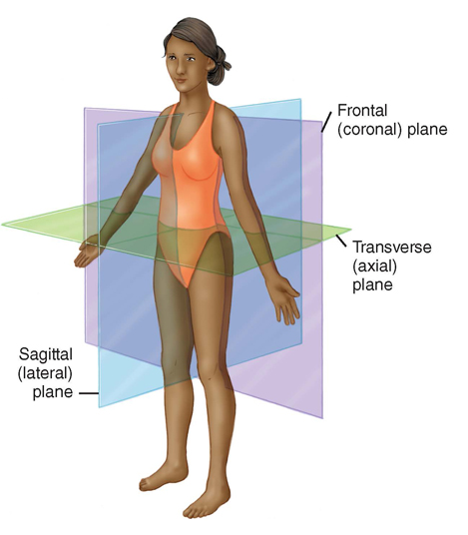
Planes of the Body (2 of 2)
FIGURE 6-1 Anatomic planes of the body.
© Jones & Bartlett Learning.
Notes:
This figure shows the planes dividing the body.

Slide 9
Cells to Systems
Cells: foundation of the human body
Tissues: cells that share a common function
Organs: groups of tissues that perform similar or interrelated jobs
Body systems: organs with similar function working together
Notes:
Lecture Outline
III. From Cells to Systems
A. Cells are the foundation of the human body.
B. Cells that share a common function form tissue.
C. Groups of tissue that perform similar or interrelated jobs form organs.
D. Organs with similar functions work together to comprise body systems.

Slide 10
The Skeletal System: Anatomy
The skeleton gives us our recognizable human form.
Composed of 206 bones
  Axial skeleton
  Appendicular skeleton
  Pelvis
Notes:
Lecture Outline
IV. The Skeletal System: Anatomy
A. The skeleton gives us our recognizable human form and protects vital internal organs.
B. Bones
1. 206 bones
a. Axial skeleton: forms the longitudinal axis of the body from the skull to the coccyx.
i. Includes the skull, facial bones, thoracic cage, and vertebral column.
b. Appendicular skeleton: comprises the upper and lower extremities and the points by which they connect to the axial skeleton.
c. The pelvis includes portions from both the axial and appendicular skeletons.

Slide 11
The Axial Skeleton
Foundation to which the arms and legs are attached
Includes:
  Skull
  Facial bones
  Thoracic cage
  Vertebral column
Notes:
Lecture Outline
B. Bones:
1. 206 bones compose the skeletal system
a. Axial skeleton: forms the longitudinal axis of the body from the skull to the coccyx.
i. Includes the skull, facial bones, thoracic cage, and vertebral column.

Slide 12
Joints (1 of 2)
Occur wherever bones come in contact
Consist of the ends of the bones and the connecting and supporting tissues
Two types of joints:
  Ball-and-socket joint
    Allows rotation and bending
  Hinge joint
    Motion restricted to flexion and extension
Notes:
Lecture Outline
C. Joints
1. Occur wherever bones come in contact
2. Ligaments are fibrous tissues that connect bone to bone, helping to stabilize the joint.
3. Cartilage is a semirigid and flexible tissue that covers and cushions the ends of articulating bones.
4. Tendons attach bone to muscle.
5. Sympheses are joins where only slight movement is possible.
6. The bone ends of a joint are held together by a fibrous sac called the joint capsule.
7. Articular cartilage allows the ends of bones to glide easily.
8. The synovial membrane is the inner lining of the joint capsule.
a. Produces synovial fluid which allow the ends of bones to glide over each other
9. Types of joints:
a. Ball-and-socket joint: allows rotation and bending.
i. The shoulder joint is an example
b. Hinge joint: motion is restricted to flexion (bending) and extension (straightening)

Slide 13
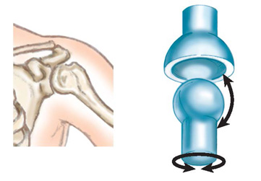
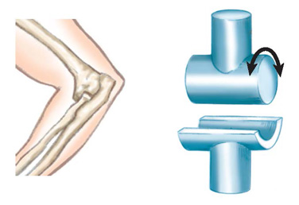
Joints (2 of 2)
FIGURE 6-4 The shoulder is an example of a
ball-and-socket joint.
FIGURE 6-5 The elbow joints are hinge joints, which allow motion in only one plane (flexion and extension).
© Jones & Bartlett Learning.
© Jones & Bartlett Learning.
Notes:
This figure shows examples of ball-and-socket (A) and hinge (B) joints.

Slide 14
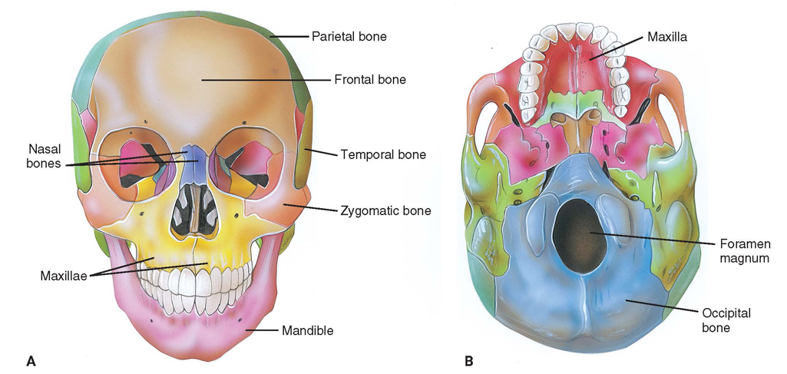
The Axial Skeleton (1 of 3)
Skull
  Cranium: made up of 4 bones
  Face: made up of 14 bones
FIGURE 6-6 The skull. A. Anterior view. B. Inferior view.
© Jones & Bartlett Learning.
Notes:
Lecture Outline
D. The axial skeleton
1. Skull
a. Consists of 28 bones divided into three groups: the cranium, the facial bones, and three small bones in the ear.
i. Cranium
a. Protects the brain and consists of 4 bones:
1. Occiput (posterior portion)
2. Temporal bones (lateral portions)
3. Parietal bone (located between the temporal bones and occiput)
4. Frontal bone (forehead)
ii. Facial bones consist of 14 bones
a. Upper, nonmovable jawbones (maxillae)
b. Cheekbones (zygomas)
c. Lower, movable portion of jaw (mandible)
d. Orbits (eye sockets) include zygomas, maxillae, and frontal bones of cranium.
e. Very short bones that form the bridge of the nose

Slide 15
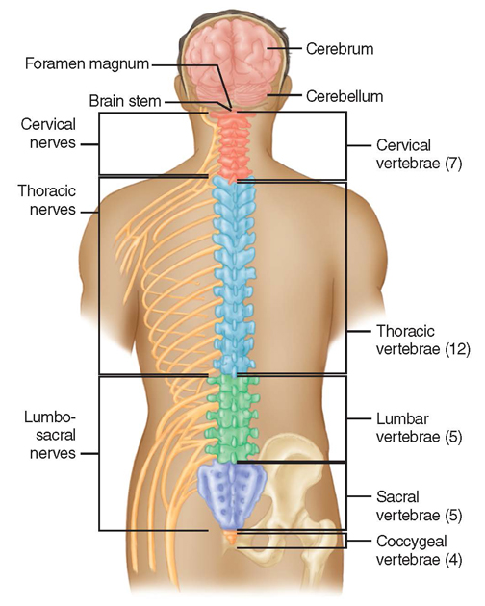
The Axial Skeleton (2 of 3)
Spinal column
  Composed of 33
  bones (vertebrae)
  Divided into 5 sections:
    Cervical
    Thoracic
    Lumbar
    Sacrum
    Coccyx
FIGURE 6-7 The vertebral column is composed of
33 bones divided into five sections.
© Jones & Bartlett Learning.
Notes:
Lecture Outline
2. Spinal column
a. Composed of 33 vertebrae divided into 5 sections from. The vertebrae in each section are numbered from top to bottom.
i. The cervical spine (neck) has 7 vertebrae.
ii. The thoracic spine (upper back) has one pair of ribs attached to each of the 12 vertebrae.
iii. The lumbar spine (lower back) has 5 vertebrae.
iv. The sacrum (back wall of pelvis) consists of 5 fused vertebrae that join the pelvis.
v. The coccyx (tailbone) consists of 4 fused vertebrae.
b. Vertebrae are connected by ligaments and are protected by intervertebral disks

Slide 16
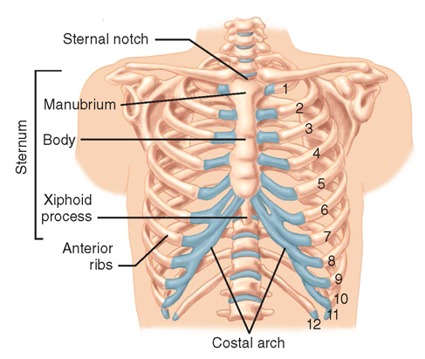
The Axial Skeleton (3 of 3)
Thorax
  Formed by of 12
  thoracic vertebrae
  and 12 pairs of ribs
  Thoracic cavity
  contains:
    Heart
    Lungs
    Esophagus
    Great vessels
FIGURE 6-8 The thorax.
© Jones & Bartlett Learning.
Notes:
Lecture Outline
3. Thorax
a. The thoracic cavity contains the heart, lungs, esophagus, and great vessels.
b. Formed by 12 thoracic vertebrae and 12 pairs of ribs
c. Midline of chest is the sternum which is made up of the manubrium, body, and xiphoid process.

Slide 17
The Appendicular Skeleton
Arms, legs, their connection points, and pelvis
Includes:
  Joints
  Upper extremities
  Pelvis
  Lower extremities
Notes:
Lecture Outline
Arms, legs, their connection points, and pelvis
Includes:
Joints
Upper extremities
Pelvis
Lower extremities

Slide 18
Upper Extremities (1 of 4)
Upper extremity extends from pectoral girdle to fingertips
  Composed of arms, forearms, hands, and fingers
Notes:
Lecture Outline
E. Appendicular skeleton
1. Upper extremities
a. Extend from the pectoral girdle to fingertips

Slide 19
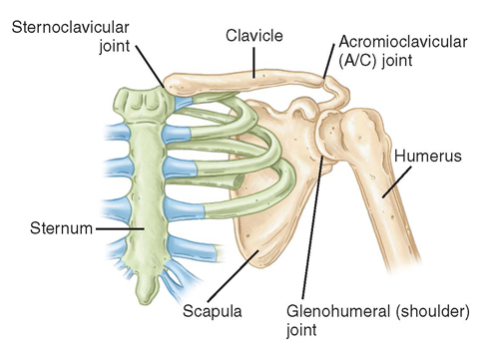
Upper Extremities (2 of 4)
Shoulder girdle: three bones come together
  Clavicle
  Scapula
  Humerus
FIGURE 6-9 The bones of the shoulder girdle include the
clavicle and scapula.
© Jones & Bartlett Learning.
Notes:
Lecture Outline
i. Shoulder girdle is where the clavicle, scapula, and humerus come together

Slide 20
Upper Extremities (3 of 4)
Arm
  Humerus is the supporting bone
  Forearm consists of the radius and ulna
  Radius on lateral side
  Ulna on medial side
Notes:
Lecture Outline
b. Arm
i. Humerus is the supporting bone
ii. Forearm consists of radius and ulna
iii. Radius lies on the lateral, or thumb, side
iv. Ulna is on the medial, or little finger, side

Slide 21
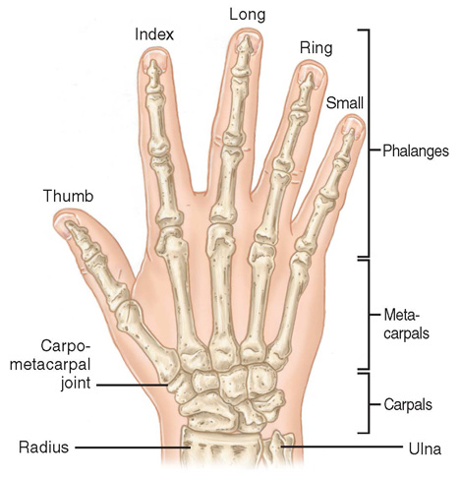
Upper Extremities (4 of 4)
Wrist and hand
  Ball-and-socket joint
  Principal bones
    Carpals
    Metacarpals
    Phalanges
FIGURE 6-10 The major bones in the wrist and hand
include the carpals, the metacarpals, and the phalanges.
© Jones & Bartlett Learning.
Notes:
Lecture Outline
v. Wrist and hand
a. Modified ball-and-socket joint formed by the ends of the radius and ulna and wrist bones
b. 5 metacarpals extend from the carpal bones and make up the hand
c. Fingers are composed of phalanges

Slide 22
The Pelvis (1 of 2)
The pelvic girdle consists of:
  Two coxae (hip bones)
  Sacrum
  Coccyx
Each pelvic bone is formed by fusion of the ilium, ischium, and pubis.
Notes:
Lecture Outline
2. Pelvis
a. Pelvic girdle consists of two large hip bones (coxae), the sacrum, and the coccyx.
b. Each coxa is formed by fusion of the ilium, ischium, and pubis.

Slide 23
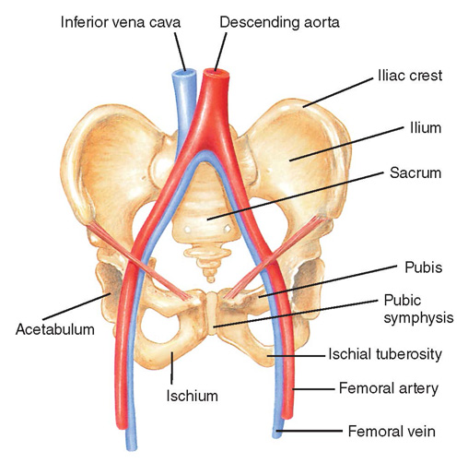
The Pelvis (2 of 2)
Posteriorly, the ilium, ischium, and pubis bones are joined by the sacrum.
Anteriorly, the pubic symphysis is where the right and left pubis are joined.
FIGURE 6-11 The pelvis is a closed, bony ring that consists of the sacrum, ilium, ischium, pubis, acetabulum, and pubic symphysis.
© Jones & Bartlett Learning.
Notes:
Lecture Outline
c. The pubic symphysis is cartilage that joins the left and right pubic bones and limits movement between the bones.

Slide 24
Lower Extremities (1 of 4)
Femur
  Longest bone in body
  Connects into the acetabulum (pelvic girdle) by a ball-and-socket joint
  The greater and lesser trochanter are where the major muscles of the thigh connect to the femur.
Notes:
Lecture Outline
3. Lower extremities
a. The femur is the longest and one of the strongest bones in the body.
i. The femoral head connects to the acetabulum (the pelvic girdle) by a ball-and-socket joint.
ii. The greater and lesser trochanters serve as anchor points for the major muscles of the thigh.

Slide 25
Lower Extremities (2 of 4)
Knee connects the upper leg to the lower leg
  Kneecap (patella)
Lower leg
  Tibia (shinbone)
    Anterior of leg
  Fibula
    Lateral side of leg
Notes:
Lecture Outline
iii. The knee is a hinge joint connecting the femur to the bones of the lower leg.
b. Lower leg
i. Tibia
ii. Fibula

Slide 26
Lower Extremities (3 of 4)
Ankle
  A hinge joint
  Allows flexion/extension of foot
Notes:
Lecture Outline
4. Ankle and foot
a. The foot comprises the tarsals, metatarsals and phalanges
b. The distal ends of the tibia and fibula articulate with the talus to form the ankle.

Slide 27
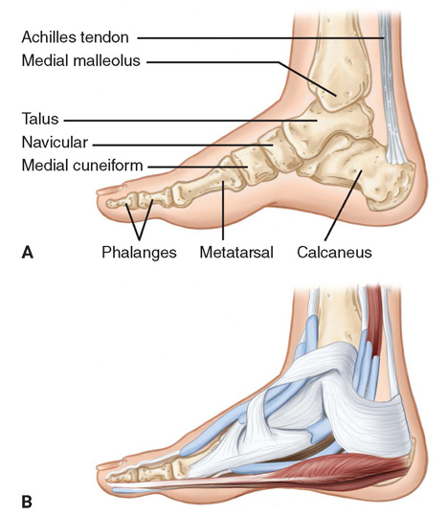
Lower Extremities (4 of 4)
Foot
  Contains 7 tarsal bones
  5 metatarsal bones form substance of foot
  Toes are formed by phalanges
FIGURE 6-13 A. The surface landmarks of the foot, including the talus, the calcaneus, and the phalanges. B. Soft tissue of the ankle.
© Jones & Bartlett Learning.
Notes:
Lecture Outline
v. Foot
a. Contains 7 tarsal bones
b. Talus and calcaneus are the largest bones
c. Talus joins with the distal tibia and fibula to form the ankle joint
c. Calcaneus forms prominence of heel
d. 5 metatarsal bones form the substance of the foot
e. Plantar surface: the bottom surface of the foot
f. Dorsum: the top of the foot
g. 5 toes formed by 14 phalanges
1. 2 phalanges in the great toe
2. 3 phalanges in each of the smaller toes

Slide 28
The Skeletal System: Physiology
The skeletal system:
  Gives the body its shape
  Protects fragile organs
  Allows for movement
  Stores calcium
  Helps create blood cells
Notes:
Lecture Outline
IV. The Skeletal System: Physiology
A. The skeletal system:
1. Gives the body its shape
2. Protects fragile organs
3. Allows for movement
4. Stores calcium
5. Helps create blood cells

Slide 29
The Musculoskeletal System: Anatomy (1 of 3)
Musculoskeletal system provides:
  Form
  Upright posture
  Movement
  Protection of vital internal organs
Notes:
Lecture Outline
V. The Musculoskeletal System: Anatomy
A. The musculoskeletal system provides:
1. Form
2. Upright posture
3. Movement
4. Protection of vital internal organs

Slide 30
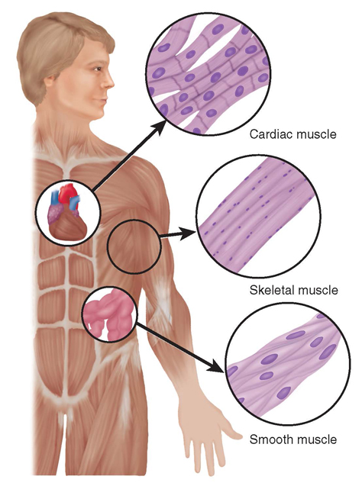
The Musculoskeletal System: Anatomy (2 of 3)
Types of muscles:
  Skeletal (voluntary) muscle
  Smooth muscle
  Cardiac muscle
FIGURE 6-14 The three types of muscle are skeletal,
smooth, and cardiac.
© Jones & Bartlett Learning.
Notes:
Lecture Outline
B. Three types of muscles: skeletal, smooth, and cardiac
1. Skeletal muscle attaches to the bones of the skeleton and forms the major muscle mass of the body.
a. Known as voluntary muscle, because it is under direct voluntary control of the brain
2. Smooth muscle and cardiac muscle movement do not require conscious thought (involuntary).
a. Smooth muscle is found within blood vessels and intestines.
b. Cardiac muscle is found only within the heart

Slide 31
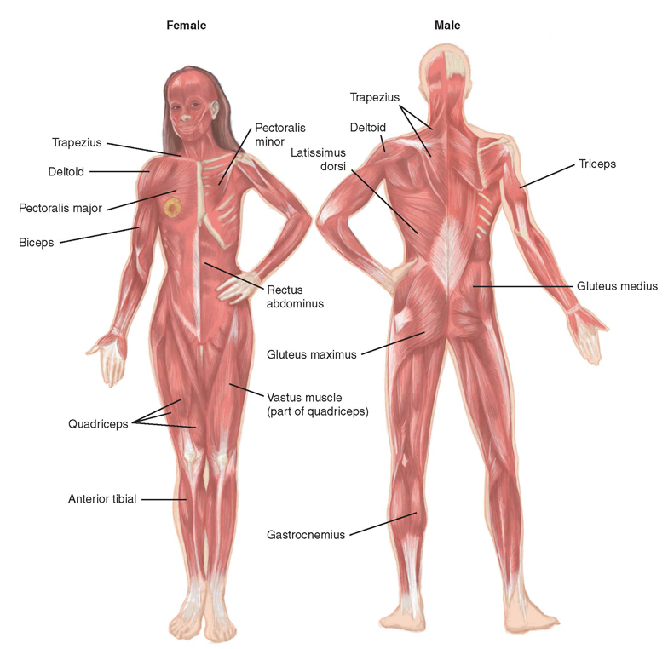
The Musculoskeletal System: Anatomy (3 of 3)
FIGURE 6-15 The major muscle groups.
© Jones & Bartlett Learning.
Notes:
This figure shows the major muscles of the human body.

Slide 32
The Musculoskeletal System: Physiology
Contraction and relaxation of system make it possible to move and manipulate the environment.
  A by-product of this movement is heat.
Another function of the muscles is to protect the structures under them.
Notes:
Lecture Outline
VI. The Musculoskeletal System: Physiology
A. Contraction and relaxation of the system make it possible to move and manipulate the environment.
1. A by-product of this movement is heat.
2. When you get cold, you shiver (involuntarily shake muscles) to produce heat.
B. Another function of muscles is to protect the structures under them.

Slide 33
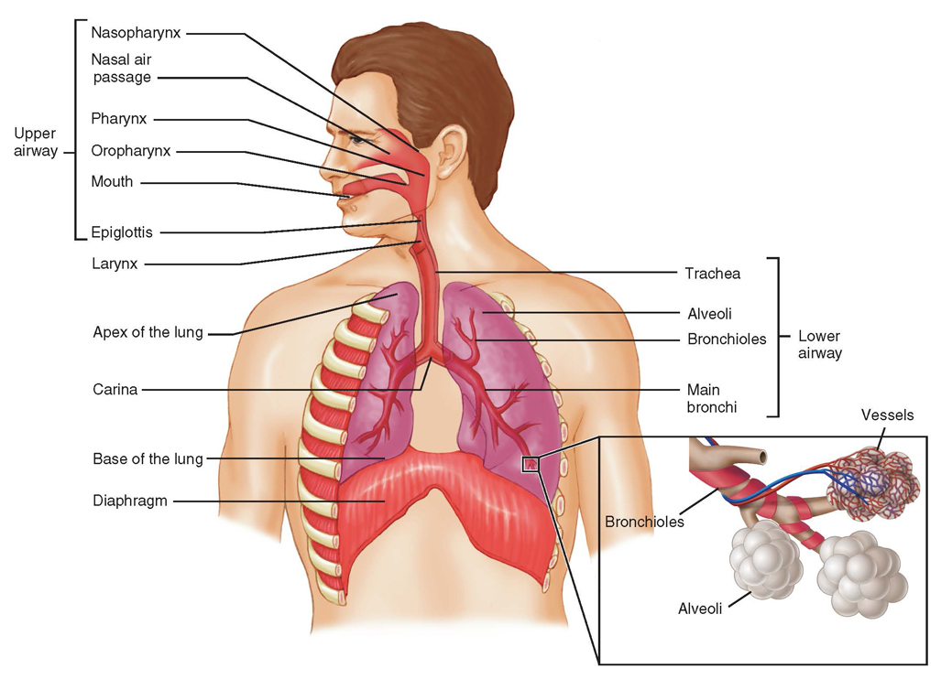
The Respiratory System: Anatomy
Structures of the body that contribute to respiration (the process of breathing)
FIGURE 6-16 The respiratory system consists of all structures of the body that contribute to the process of breathing.
© Jones & Bartlett Learning.
Notes:
Lecture Outline
VII. The Respiratory System: Anatomy
A. The respiratory system is responsible for breathing, or respiration, and exchange of oxygen and carbon dioxide within the lungs.

Slide 34
Upper Airway (1 of 2)
Includes:
  Nose
  Mouth (oral cavity)
  Tongue
  Jaw (mandible)
  Larynx
    Divides upper and lower airway
Notes:
Lecture Outline
B. Upper airway
1. Nose
2. Mouth (oral cavity)
3. Tongue
4. Jaw (mandible)
5. Larynx (voice box)
a. Dividing line between the upper and lower airway

Slide 35
Upper Airway (2 of 2)
Includes: (cont’d)
  Pharynx
    Nasopharynx
    Oropharynx
    Laryngopharynx
  Trachea
    Epiglottis
Notes:
Lecture Outline
6. Pharynx
a. Nasopharynx
b. Oropharynx (throat)
c. Laryngopharynx
7. Trachea (windpipe)
a. Located at the bottom of the pharynx
b. Semi-rigid, enclosed air tube made up of rings of cartilage
8. Epiglottis
a. Thin, leaf-shaped flap that prevents food and liquid from entering the trachea

Slide 36
Lower Airway
Thyroid cartilage
  Adam’s apple
Cricoid cartilage: immediately below the thyroid cartilage
  Cricothyroid membrane
Trachea
  Ends at carina, dividing into right and left bronchi leading to bronchioles
Notes:
Lecture Outline
C. Lower airway
1. Thyroid cartilage (Adam’s apple): forms the anterior part of the larynx
2. Cricoid cartilage: immediately below the thyroid cartilage
3. Cricothyroid membrane: between the thyroid and cricoid cartilage
4. Trachea: below the cricoid cartilage
a. The trachea ends at the carina.
b. It divides into the right and left main stem bronchi, which enter the lungs and branch into smaller airways.

Slide 37
Lungs (1 of 3)
The two lungs are held in place by:
  Trachea
  Arteries and veins
  Pulmonary ligaments
Divided into two lobes
  Right lung has upper, middle, and lower lobes
  Left lung has upper and lower lobes
Notes:
Lecture Outline
D. Lungs
1. The two lungs are held in place by:
a. Trachea
b. Arteries and veins
c. Pulmonary ligaments
2. Each lung is divided into lobes.
a. The right lung has upper, middle, and lower lobes.
b. The left lung has upper and lower lobes.

Slide 38
Lungs (2 of 3)
Within the lobes are bronchi, bronchioles, and alveoli.
  Allow for gas exchange
Pleura: a layer of smooth, glistening tissue that covers each lung and lines the chest cavity
  Between the two layers is a small amount of fluid that allows the tissues to glide smoothly.
Notes:
Lecture Outline
D. Lungs
1. Each lung is divided into lobes.
2. Within the lobes are the bronchi and bronchioles, which end in alveoli.
a. Alveoli allow for gas exchange (oxygen and carbon dioxide).
E. Mechanics of breathing
1. Pleura
a. Visceral pleura covers the lungs
b. Parietal pleura lines the chest wall
c. A thin layer of fluid between them facilitates movement of the lungs.
d. The pleural space is a potential space between the two pleura

Slide 39
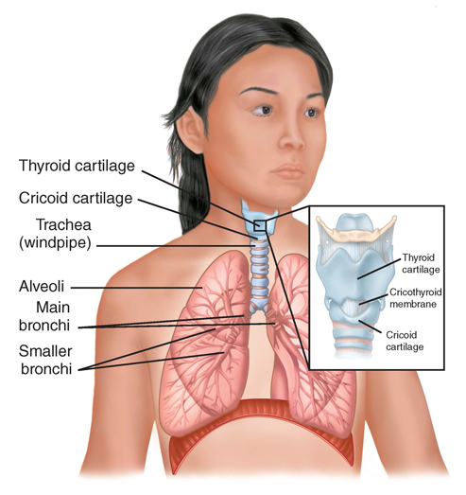
Lungs (3 of 3)
FIGURE 6-17 The lungs contain millions of air sacs (alveoli), which lie at the ends of air passages. Small blood vessels surround the alveoli, allowing for gas exchange.
© Jones & Bartlett Learning.
Notes:
This figure shows the structures of the lungs.

Slide 40
Muscles of Breathing
Diaphragm is the primary muscles of breathing.
Also involved are:
  Neck (cervical muscles)
  Intercostal muscles
  Abdominal muscles
  Pectoral muscles
Notes:
Lecture Outline
2. Muscles of breathing
a. The diaphragm is the primary muscle of breathing
i. Contains voluntary and involuntary muscle
b. Cervical muscles
c. Intercostal muscles
d. Abdominal muscles
e. Pectoral muscles

Slide 41
Inhalation
Diaphragm and intercostal muscles contract
Pressure in the thoracic cavity decreases
Lungs fill with air
Active part of the respiratory cycle
Notes:
Lecture Outline
3. Inhalation
a. Diaphragm and intercostal muscles contract enlarging the thoracic cage
b. Pressure within the thoracic cavity decreases and the lungs fill (negative-pressure ventilation).
c. Active part of the respiratory cycle

Slide 42
Exhalation
Diaphragm and intercostal muscles relax
Thoracic cavity returns to it normal shape and volume
Passive portion of the respiratory cycle
Notes:
Lecture Outline
4. Exhalation
a. Diaphragm and intercostal muscles relax
b. Thoracic cavity returns to its normal shape and volume
c. Passive portion of the respiratory cycle

Slide 43
The Respiratory System: Physiology (1 of 6)
Function is to provide body with oxygen and eliminate carbon dioxide
Ventilation and respiration are two separate, interdependent functions of the respiratory system.
Notes:
Lecture Outline
VIII. The Respiratory System: Physiology
A. The respiratory system’s function is to provide the body with oxygen and eliminate carbon dioxide.
Ventilation and respiration are two separate, yet interdependent functions of the respiratory system.
1. Ventilation is the movement of air between the lungs and the environment
2. Respiration: the exchange of oxygen and carbon dioxide in the alveoli and in tissues of the body

Slide 44
The Respiratory System: Physiology (2 of 6)
Respiration is the exchange of oxygen and carbon dioxide in the alveoli and tissues.
  Provides oxygen to the cells and removes waste carbon dioxide
  Diffusion: passive process in which molecules move from an area of higher concentration to an area of lower concentration
Notes:
Lecture Outline
C. Respiration
1. Oxygen and carbon dioxide move across the membrane between the capillaries and alveoli via diffusion.
a. Diffusion is a passive process in which molecules move from an area with a higher concentration of molecule to an area of lower concentration.

Slide 45
The Respiratory System: Physiology (3 of 6)
Chemical control of breathing
  Brainstem controls breathing by monitoring carbon dioxide in blood and spinal fluid.
  Primary reason for breathing is to lower carbon dioxide levels.
  Hypoxic drive
Notes:
Lecture Outline
D. The chemical control of breathing
1. The brainstem controls breathing by monitoring levels of carbon dioxide in the blood and spinal fluid.
2. Breathing is automatically controlled if the level of carbon dioxide or oxygen in the arterial blood is too high or too low.
3. Breathing occurs as the result of a buildup of carbon dioxide in the cerebrospinal fluid which causes the pH to decrease.
a. The medulla oblongata stimulates the phrenic nerve causing the diaphragm to contract.
b. The primary reason for breathing is to lower carbon dioxide levels not to increase oxygen levels.
4. Hypoxic drive “back-up” system to control respiration.
a. The stimulus to breathe comes from low oxygen levels

Slide 46
The Respiratory System: Physiology (4 of 6)
Nervous system control of breathing
  The medulla initiates ventilation cycles.
    Stimulated by high carbon dioxide levels
  The pons has two areas that help augment respirations during emotional or physical stress.
Notes:
Lecture Outline
E. The nervous system control of breathing
1. Medulla oblongata
a. Responsible for initiating the ventilation cycle
b. Primarily stimulated by high carbon dioxide levels
c. Helps control the rhythm of breathing, initiate inspiration, set the base pattern for respiration, and send the signal to the diaphragm via the phrenic nerve.
2. Pons
a. Has two areas which help augment respirations during emotional or physical stress.
b. Helps change the depth of inspiration, expiration, or both.

Slide 47
The Respiratory System: Physiology (5 of 6)
Ventilation is simple air movement into and out of the lungs.
  Requires chest rise and fall
  Tidal volume: amount of air moved into or out of the lungs during a single breath
  Residual volume: the gas that remains in the lungs to keep the lungs open
Notes:
Lecture Outline
F. Ventilation
1. Tidal volume
a. Amount of air that is moved into or out of the lung in a single breath.
b. Generally 500 mL in an adult
2. Inspiratory reserve volume is the deepest breath you can take after a normal breath.
3. Expiratory reserve volume is the maximum amount of air you can forcibly breathe out after a normal breath,
4. Residual volume is the gas remaining in the lungs after exhalation.

Slide 48
The Respiratory System: Physiology (6 of 6)
Dead space: the portion of the respiratory system that has no alveoli and where little or no exchange of gas between air and blood occurs
Respiratory rate × tidal volume = minute volume
Notes:
Lecture Outline
5. Dead space is the portion of the respiratory system that has no alveoli and little to no gas exchange.
Minute ventilation
a. Used to assess the adequacy of ventilation
b. Amount of air that moves in and out of the lungs in one minute
c. Minute volume = respiratory rate x tidal volume

Slide 49
Characteristics of Normal Breathing
Normal rate and depth (tidal volume)
Regular rhythm or pattern of inhalation and exhalation
Clear, audible breath sounds on both sides of chest
Regular rise and fall movement on both sides of the chest
Movement of the abdomen
Notes:
Lecture Outline
G. Normal breathing
1. Normal rate and depth (tidal volume)
2. Regular rhythm or pattern of inhalation and exhalation
3. Clear, audible breath sounds on both sides of chest
4. Regular rise and fall movement on both sides of the chest
5. Movement of the abdomen

Slide 50
Inadequate Breathing Patterns in Adults
Labored breathing
Muscle retractions
Pale, cyanotic, cool, damp skin
Tripod position
Agonal gasps
Notes:
Lecture Outline
H. Inadequate breathing patterns
1. Labored breathing
a. Significant effort requiring the use of accessory muscles
2. Breathing slower than 12 breaths/min or more than 20 breaths/min
3. Additional signs
a. Muscle retractions above the clavicles, between the ribs, and below the rib cage
b. Pale or cyanotic skin
c. Cool, damp skin
d. Tripod position

Slide 51
The Circulatory System: Anatomy (1 of 2)
Complex arrangement of connected tubes
  Arteries, arterioles, capillaries, venules, and veins
Two circuits
  Systemic circulation (body)
  Pulmonary circulation (lungs)
Notes:
Lecture Outline
IX. The Circulatory System: Anatomy
A. The circulatory system (cardiovascular system) is a complex arrangement of connected tubes.
1. Arteries, arterioles, capillaries, venules, and veins
B. Two circuits
1. Systemic circulation carries oxygen-rich blood from the left ventricle through the body and back to the right atrium
2. Pulmonary circulation carries oxygen-poor blood from the right ventricle through the lungs and back to the left atrium

Slide 52
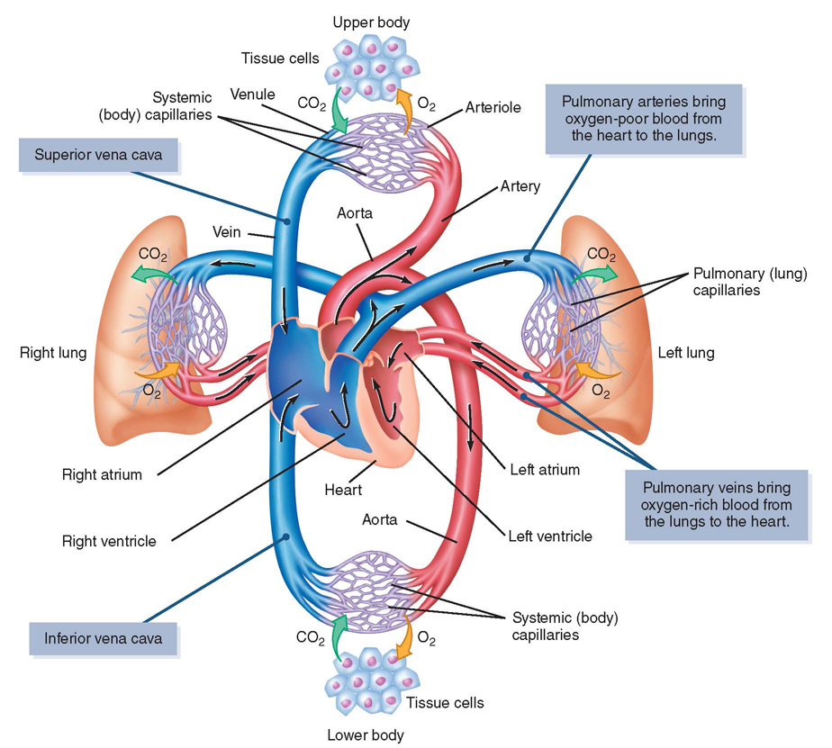
The Circulatory System: Anatomy (2 of 2)
FIGURE 6-25 The circulatory system includes the heart, arteries, veins, and interconnecting capillaries. The capillaries are the smallest vessels and connect venules and arterioles. At the center of the system, and providing its driving force, is the heart. Blood circulates through the body under pressure generated by the two sides of the heart.
© Jones & Bartlett Learning.
Notes:
This figure shows the circulatory system.

Slide 53
The Heart (1 of 5)
Hollow muscular organ
Made of specialized cardiac muscle
Works as two paired pumps
Each side is divided into:
  Atrium (upper chamber)
  Ventricle (lower chamber)
Notes:
Lecture Outline
C. Heart
1. An involuntary muscle made of specialized cardiac muscle (myocardium)
2. Works as two paired pumps
3. Each side is divided into:
a. Left side is muscular and a high-pressure pump
b. Right side is thinner and a low-pressure pump
c. Atrium (upper chamber)
d. Ventricle (lower chamber)

Slide 54
The Heart (2 of 5)
Circulation
  The heart receives its blood from the aorta.
  Right side receives deoxygenated blood from the veins.
  Left side receives oxygenated blood from the lungs.
Notes:
Lecture Outline
4. Circulation
a. The heart receives its blood from the aorta via coronary arteries.
b. The right side of the heart receives deoxygenated blood from the veins of the body.
c. Oxygenated blood returns from the lungs through the pulmonary veins into the left side of the heart and is pumped into the aorta and then to the arteries of the body.
d. Valves guide the path of blood through the heart

Slide 55
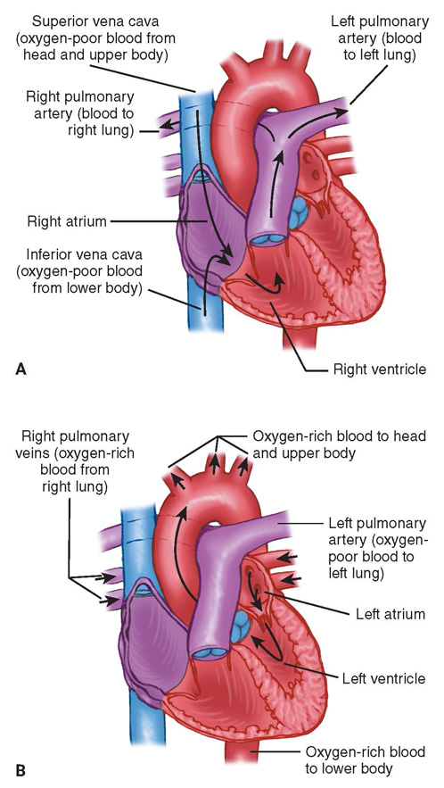
The Heart (3 of 5)
FIGURE 6-27 A. The right (lower pressure) side of the
heart pumps blood from the body through the lungs.
B. The left (higher-pressure) side of the heart pumps
oxygen-rich blood to the rest of the body.
© Jones & Bartlett Learning.
Notes:
This figure shows the right and left sides of the heart.

Slide 56
The Heart (4 of 5)
Normal resting heart rate (HR) is 60–100 beats/min.
Stroke volume (SV)
  Amount of blood moved by one beat
Cardiac output (CO)
  Amount of blood moved in 1 minute
  HR × SV = CO
Notes:
Lecture Outline
Normal heartbeat
a. Normal pulse rate for an adult is 60–100 beats/min
b. Stroke volume (SV): the amount of blood moved by one beat
c. Cardiac output (CO): the amount of blood moved in 1 minute.
i. CO = HR × SV

Slide 57
The Heart (5 of 5)
Electrical conduction system
  Specialized tissue capable of initiating and conducting electrical current
  Causes smooth, coordinated contractions
  Contractions produce pumping action
Notes:
Lecture Outline
7. Electrical conduction system
a. A network of specialized tissue that is capable of initiating and conducting electrical current runs throughout the heart.
b. Electrical impulses begin high in the atria at the sinoatrial (SA) node, travel to the atrioventricular (AV) node and bundle of His, and then move through the Purkinje fibers to the ventricles.
c. This movement produces a smooth flow of electricity, producing a coordinated pumping action.
d. If injured, the heart will not beat properly.

Slide 58
Arteries (1 of 4)
Arteries carry blood from the heart to all body tissues.
Aorta branches into:
  Coronary arteries
  Carotid arteries
  Hepatic arteries
  Renal arteries
  Mesenteric arteries
Notes:
Lecture Outline
D. Arteries
1. Carry blood from the heart to all body tissues
2. Aorta
a. Main artery leaving the left side of the heart and carrying freshly oxygenated blood to the body
b. Has many branches that supply the vital organs

Slide 59
Arteries (2 of 4)
Pulmonary artery
  Carries oxygen-poor blood to the lungs
Arteries branch into smaller arteries and then into arterioles.
  Arterioles branch into a series of increasingly smaller vessels until they connect to the capillaries.
Notes:
Lecture Outline
3. Pulmonary artery originates at the right ventricle and carries oxygen-poor blood to the lungs
4. Arteries branch into smaller arteries, and then into arterioles.
a. Arterioles branch into a series of increasingly smaller vessels until they connect to the vast network of capillaries.

Slide 60
Arteries (3 of 4)
Pulse
  Palpated most easily at the neck, wrist, or groin
  Created by forceful pumping of blood out of the left ventricle and into the major arteries
Notes:
Lecture Outline
5. Pulse is created by the forceful pumping of blood out of the left ventricle and into the major arteries
a. Palpated most easily at the neck, wrist, or groin

Slide 61
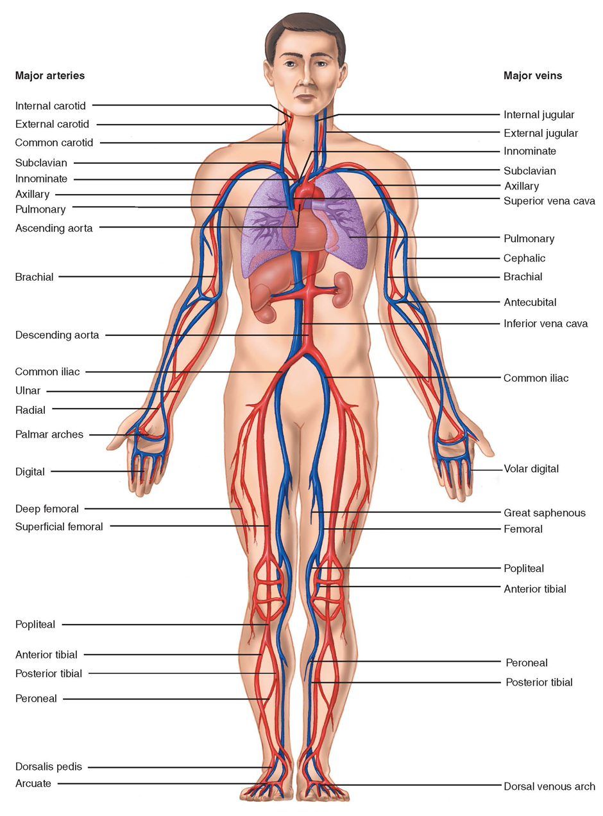
Arteries (4 of 4)
FIGURE 6-28 The main arteries supply blood to a vast network of smaller arteries and arterioles. Venules deliver oxygen-poor blood to the veins that return blood to the heart.
© Jones & Bartlett Learning.
Notes:
This figure shows the major arteries of the human body.

Slide 62
Capillaries
Connect arterioles to venules
Fine end divisions of arterial system
Allow contact between blood and cells
Notes:
Lecture Outline
E. Capillaries
1. Tiny blood vessels that connect arterioles to venules
2. Oxygen and nutrients pass from blood cells and plasma in the capillaries to individual tissue cells through the very thin walls of capillaries.
3. Capillaries allow blood to move through them one cell at a time,

Slide 63
Veins
Return oxygen-depleted blood to the heart
The superior vena cava carries blood returning from the head, neck, shoulders, and upper extremities.
The inferior vena cava carries blood from the abdomen, pelvis, and lower extremities.
Join at right atrium
Notes:
Lecture Outline
F. Veins
1. Return oxygen-depleted blood to the heart
2. Have thinner walls than arteries and are generally larger in diameter
3. Major veins
a. The superior vena cava carries blood returning from the head, neck, shoulders, and upper extremities.
b. The inferior vena cava carries blood from the abdomen, pelvis, and lower extremities.
4. Systemic vascular resistance (SVR)
a. The resistance to blood flow within all blood vessels except the pulmonary vessels.

Slide 64
The Spleen
Solid organ located under the rib cage
Filters blood
Particularly susceptible to injury from blunt trauma
Notes:
Lecture Outline
G. Spleen
1. Solid organ located under the rib cage in left upper part of abdomen
2. Filters worn-out blood cells, foreign substances, and bacteria from the blood
3. Highly vascular and is particularly susceptible to injury from blunt trauma

Slide 65
Blood Composition
Plasma (liquid)
Red blood cells (erythrocytes)
White blood cells (leukocytes)
Platelets
Notes:
Lecture Outline
H. Blood composition
1. Plasma (the liquid portion of blood) contains:
a. Water (primary component)
b. Proteins (primary component)
c. Oxygen, carbon dioxide, nitrogen
d. Nutrients
2. Red blood cells (erythrocytes)
a. Contain hemoglobin, which carries oxygen
3. White blood cells (leukocytes)
a. Play a role in the body’s immune defense to fight infection
4. Platelets
a. Essential in the initial formation of a blood clot

Slide 66
The Circulatory System: Physiology (1 of 2)
Blood pressure: pressure that blood exerts against the walls of arteries
Systole: when the left ventricle of the heart contracts, it pumps blood from the ventricle into the aorta.
Diastole: when the muscle of the ventricle relaxes, the ventricle fills with blood.
Notes:
Lecture Outline
X. The Circulatory System: Physiology
A. Blood pressure: pressure that blood exerts against the walls of arteries
B. Systole: When the left ventricle of heart contracts, it pumps blood from the ventricle into the aorta.
C. Diastole: When the muscle of the ventricle relaxes, the ventricle fills with blood.

Slide 67
The Circulatory System: Physiology (2 of 2)
Blood pressure readings
  Systolic blood pressure: high point of wave
  Diastolic blood pressure: low point of wave
Notes:
Lecture Outline
D. Forceful ejection of blood from the left ventricle into the aorta is transmitted through the arteries as a pulsatile pressure wave.
1. Can be measured with a blood pressure cuff (sphygmomanometer)
2. Systolic blood pressure: high point of wave as heart is contracting
3. Diastolic blood pressure: low point of wave as heart is in relaxation phase
4. Expressed in millimeters of mercury (mm Hg)

Slide 68
Normal Circulation in Adults
Automatically adjusted and controlled
Perfusion: circulation of blood in organ or tissue in adequate amounts to meet the needs of cells
Hypoperfusion: inadequate blood supply to organs, tissues, and cells
Notes:
Lecture Outline
E. Normal circulation in adults
1. Automatically adjusted and controlled
2. Perfusion: the circulation of blood in an organ or tissue in adequate amounts to meet the current needs of the cells
3. Hypoperfusion: inadequate blood supply to organs, tissues, and cells.
a. Also called shock

Slide 69
Inadequate Circulation in Adults
The system can adjust to small blood loss.
  Vessels constrict.
  The heart pumps more rapidly.
With a large loss, adjustment fails, and the patient goes into shock.
Mean arterial pressure can help detect shock.
Notes:
Lecture Outline
F. Inadequate circulation in adults
1. The system can adjust to a small blood loss.
a. Vessels constrict.
b. The heart pumps more rapidly.
2. With a large loss, adjustment fails, and the patient goes into shock.
3. Mean arterial pressure can help detect shock
a. The average arterial pressure during systole and diastole
b. MAP = CO x SVR

Slide 70
Functions of Blood
Fighting infection
Transporting oxygen
Transporting carbon dioxide
Controlling pH
Transporting wastes and nutrients
Clotting (coagulation)
Notes:
Lecture Outline
G. Functions of blood
1. Fighting infection
2. Transporting oxygen
3. Transporting carbon dioxide
4. Controlling pH
5. Transporting wastes and nutrients
6. Clotting (coagulation)

Slide 71
Nervous System Control of the
Cardiovascular System (1 of 2)
Sympathetic nervous system is responsible for fight-or-flight response.
  Sends commands to adrenal glands
  Epinephrine (adrenaline) and norepinephrine (noradrenaline) are secreted to stimulate heart and blood vessels.
Notes:
Lecture Outline
H. Nervous system control of the cardiovascular system
1. The sympathetic nervous system is responsible for the fight-or-flight response.
a. Sends commands to adrenal glands
b. Epinephrine and norepinephrine are secreted to stimulate heart and blood vessels.

Slide 72
Nervous System Control of the
Cardiovascular System (2 of 2)
Blood vessels have alpha-adrenergic receptors.
The heart and lungs have beta-adrenergic receptors.
Baroreceptors sense pressure in the blood vessels.
The sympathetic and parasympathetic nervous system balance each other.
Notes:
Lecture Outline
1. Sympathetic nervous system
a. The heart and blood vessels have alpha-adrenergic receptors and beta-adrenergic receptors.
i. Adrenergic means related to the adrenal gland where epinephrine and norepinephrine are made.
b. Alpha-adrenergic receptors are found in blood vessels.
i. When stimulated, blood vessels contract
c. Beta-adrenergic receptors are found in the heart and lungs
i. When beta-1 receptors are stimulated, the heart rate and force of contraction increase.
ii. When beta-2 receptors are stimulated, the bronchi in the lungs dilate
2. Parasympathetic nervous system
a. Causes the heart rate to slow and beat more weakly
3. The sympathetic and parasympathetic nervous system balance each other
4. Baroreceptors sense pressure in the blood vessels
a. Found in the aorta and carotid bodies
b. Cause stimulation of the sympathetic nervous system and parasympathetic nervous system to adjust blood pressure.

Slide 73
The Nervous System: Anatomy and Physiology
The nervous system is perhaps the most complex organ in the body.
Divided into two main portions:
  Central nervous system (CNS)
  Peripheral nervous system
Notes:
Lecture Outline
XI. The Nervous System: Anatomy and Physiology
A. The nervous system is perhaps the most complex organ system in the body.
1. Divided into two main portions
a. Central nervous system (CNS): the brain and spinal cord
b. Peripheral nervous system (nerves outside the brain and spinal cord)
i. Somatic nervous system regulates voluntary activities
ii. Autonomic nervous system controls functions that occur automatically

Slide 74
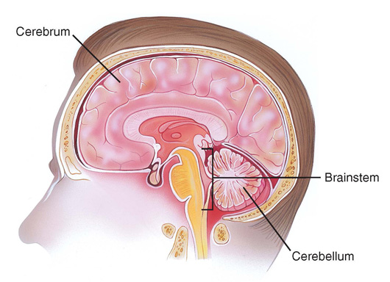
Central Nervous System (1 of 3)
Brain
  Controlling organ of the body
  Subdivisions
    Cerebrum
    Cerebellum
    Brainstem
FIGURE 6-34 The brain lies well protected within the skull. Its major subdivisions are the cerebrum, the cerebellum, and the brainstem.
© Jones & Bartlett Learning.
Notes:
Lecture Outline
1. Brain
a. Cerebrum
i. Largest part of the brain
ii. Surface is made up of neurons
iii. Responsible for higher brain function
iv. Can be divided into to halves or hemispheres
(a) Each hemisphere has four lobes
(i) Frontal lobe: personality, judgement, planning, problem solving, concentration, and self-awareness.
(ii) Parietal lobe: spatial recognition
(iii) Occipital lobe: vision
(iv) Temporal lobe: taste, hearing, and ability to understand words
b. Cerebellum
i. Controls balance, muscle coordination, and posture
c. Brainstem
i. Controls body functions necessary for life, including cardiac and respiratory functions and regulation of consciousness
ii. Comprised of the midbrain, the pons, and the medulla oblongata
iii. Reticular activating system: regulates consciousness

Slide 75
Central Nervous System (2 of 3)
Cerebrospinal fluid
  Cushions and protects the brain and spinal cord
Circulation in the head
  Oxygenated blood is supplied via carotid arteries
  Deoxygenated blood is drained by the internal and external jugular veins
Notes:
Lecture Outline
d. Cerebrospinal fluid (CSF)
i. Filters out impurities and toxins
ii. Cushions the brain and spinal cord.
Circulation in the head
i. Oxygenated blood is supplied via the carotid arteries
ii. Deoxygenated blood is drained from the head via the internal and external jugular veins.

Slide 76
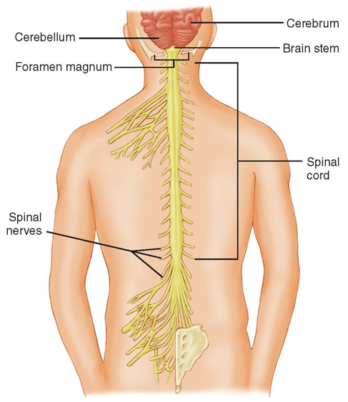
Central Nervous System (3 of 3)
Spinal cord
  Extension of the brainstem
  Transmits messages between brain and body
FIGURE 6-35 The spinal cord is a continuation of the
brainstem. It exits the skull at the foramen magnum and
extends down to the level of the second lumbar vertebra.
© Jones & Bartlett Learning.
Notes:
Lecture Outline
2. Spinal cord
a. An extension of the brainstem
b. Leaves the skull via the foramen magnum
c. Encased with the vertebral column
d. Ends at the level of the second lumbar vertebra
e. Primary function is to transmit messages between the brain and spinal cord.

Slide 77
Peripheral Nervous System (1 of 3)
Divided into two main portions:
  Somatic nervous system
  Autonomic nervous system
Notes:
Lecture Outline
2. Peripheral nervous system
a. Divided into two main portions
i. Somatic nervous system (voluntary)
(a) Transmits signals from the brain to voluntary muscles
(b) Allows for activities such as walking, talking, and writing
ii. Autonomic nervous system (involuntary)
(a) Sympathetic nervous system
(b) Parasympathetic nervous system

Slide 78
Peripheral Nervous System (2 of 3)
Somatic nervous system
  Transmits signals from brain to voluntary muscles
Autonomic nervous system
  Involuntary actions
  Split into two areas
    Sympathetic nervous system (fight-or-flight)
    Parasympathetic nervous system (slows body)
Notes:
Lecture Outline
i. Somatic nervous system (voluntary)
a. Transmits signals from the brain to voluntary muscles
b. Allows for activities such as walking, talking, and writing
ii. Autonomic nervous system (involuntary)
a. Sympathetic nervous system
b. Parasympathetic nervous system

Slide 79
Peripheral Nervous System (3 of 3)
Two types of nerves within peripheral nervous system
  Sensory nerves carry information from body to CNS.
  Motor nerves carry information from CNS to muscles.
Notes:
Lecture Outline
c. Two types of nerves within peripheral nervous system
i. Sensory nerves carry information from the body to the CNS
ii. Motor nerves carry information from the brain to muscles.

Slide 80
The Integumentary System (Skin): Anatomy (1 of 2)
Two layers
  Epidermis (superficial)
  Dermis (deeper)
Subcutaneous tissue lies beneath the skin.
  Fat that insulates and serves as energy reservoir
Notes:
Lecture Outline
XII. The Integumentary System (Skin): Anatomy
A. Two layers of skin
1. Epidermis (superficial)
a. Sealed to form a watertight, protective covering
b. Composed of several layers of cells
i. Germinal layer: produces new cells
ii. Stratum corneal layer: surface layer of dead cells
iii. Skin cells are constantly being replaced
2. Dermis (deeper)
a. Contains special structures of the skin
i. Sweat glands produce sweat for cooling the body.
ii. Sebaceous glands secrete sebum, which provides waterproofing and softening.
iii. Hair follicles are small organs that produce hair.
iv. Blood vessels provide nutrients and oxygen to the skin.
v. Mucous membranes
B. Below the skin lies subcutaneous tissue, a layer of fat that serves as an insulator and as an energy reservoir.

Slide 81
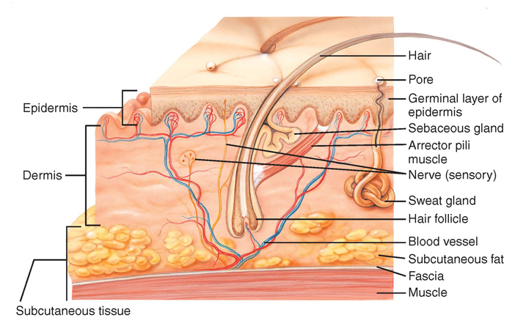
The Integumentary System (Skin): Anatomy (2 of 2)
FIGURE 6-36 The layers of the skin can be divided between the epidermis and the dermis. Below the skin is a layer of subcutaneous tissue.
© Jones & Bartlett Learning.
Notes:
This figure shows the layers of the skin.

Slide 82
The Integumentary System (Skin): Physiology
The skin is the largest single organ in the body.
Three major functions
  Protects the body in the environment
  Regulates body temperature
  Transmits information from environment to brain
Notes:
Lecture Outline
XIII. The Integumentary System (Skin): Physiology
A. The skin is the largest single organ in the body.
B. Three major functions:
1. Protects the body in the environment
2. Regulates body temperature
3. Transmits information from the environment to the brain

Slide 83
The Digestive System: Anatomy (1 of 4)
Gastrointestinal system
Abdomen: the second major body cavity
  Contains major organs of digestion and excretion
  Organized into 4 quadrants:
    Right upper
    Lower upper
    Right lower
    Left lower
Notes:
Lecture Outline
The Digestive System: Anatomy
A. Digestive system is also called the gastrointestinal system
B. Components of the digestive system
1. Abdomen
a. Contains major organs of digestion and excretion
b. Quadrants are the easiest way to identify areas.
2. Organs and vascular structures
a. Right upper (RUQ): contains the liver, gallbladder, and a portion of the colon
b. Left upper (LUQ): contains the stomach, spleen, and a portion of the colon
c. Right lower (RLQ): contains two portions of the large intestine (cecum and ascending colon)
d. Left lower (LLQ): contains the descending and sigmoid portions of the colon
e. The small intestine, pancreas, large intestine, and urinary bladder lie in more than one quadrant.
f. The kidneys and pancreas lie behind the abdominal cavity (retroperitoneal)

Slide 84
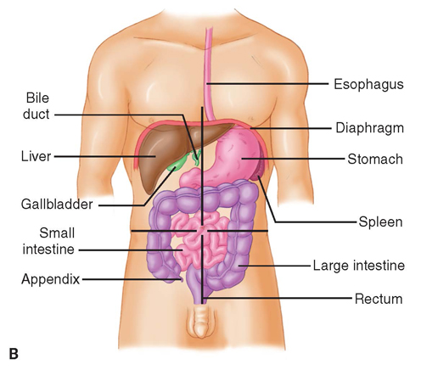
The Digestive System: Anatomy (2 of 4)
FIGURE 6-38 Several of the organs in the
abdomen lie in more than one quadrant.
© Jones & Bartlett Learning.
Notes:
This figure shows the main organs of the digestive system.

Slide 85
The Digestive System: Anatomy (3 of 4)
Mouth
  Lips, cheeks, gums, teeth, tongue
  Salivary glands
Oropharynx
Esophagus
Stomach
Pancreas
Notes:
Lecture Outline
3. Mouth
a. Consists of lips, cheeks, gums, teeth, and tongue
b. Hard and soft palate
c. Salivary glands
i. Two sets: on each side of the mouth and in front of each ear
ii. Saliva is approximately 98% water and 2% mucus, salts, and organic compounds
4. Oropharynx
a. Tubular structure that extends from the back of the mouth to the esophagus and trachea
5. Esophagus
a. Collapsible tube about 10 inches long extending from the end of the pharynx to the stomach
b. Muscles in the wall of the esophagus propel food to the stomach.
6. Stomach
a. Hollow organ in LUQ
b. Receives food, stores it, and provides for its movement into the bowel
7. Pancreas
a. Flat, solid organ that lies below and behind the liver and stomach
b. Two portions: exocrine and endocrine
i. Exocrine portion secretes pancreatic juice containing enzymes that aid in digestion of fat, starch, and protein.
ii. Endocrine portion (islets of Langerhans) produces insulin and glucagon.

Slide 86
The Digestive System: Anatomy (4 of 4)
Liver
  Bile ducts
Small intestine
Large intestine
Appendix
Rectum
Notes:
Lecture Outline
8. Liver
a. Large, solid organ immediately beneath the diaphragm in the RUQ, extending into the LUQ
b. The liver has many functions:
i. Filtering harmful substances
ii. Forming the factors needed for blood clotting and normal plasma production
iii. Storing sugar or starch for immediate use by the body for energy
c. Bile ducts
i. Bile ducts connect the liver to the intestine.
ii. Carries bile from the liver to the gallbladder where bile is stored, to the duodenum
9. Small intestine
a. Major hollow organ of the abdomen
b. Produces enzymes and mucus to aid in digestion
c. Composed of the duodenum , jejunum, and ileum
10. Large intestine
a. Major hollow organ consisting of the cecum, colon, and rectum
b. The major function of the colon is to absorb the final 5–10% of digested food and water from the intestine to form solid stool.
11. Appendix
a. A 3- to 4-inch-long tube that opens into the cecum (first part of large intestine) in the RLQ of the abdomen
b. It may easily become obstructed, inflamed, or infected (appendicitis).
12. Rectum
a. Large, hollow organ adapted to hold quantities of feces until it is expelled
b. At its terminal end is the anus.
c. Sphincters control the escape of liquids, gases, and solids from the digestive tract.

Slide 87
The Digestive System: Physiology
Enzymes are added to food.
  By salivary glands, stomach, liver, pancreas, and small intestine
Food is converted into basic sugars, fatty acids, and amino acids.
  Further processed by liver
  Circulated via blood throughout body
Notes:
Lecture Outline
XV. The Digestive System: Physiology
A. Digestion is a complicated chemical process.
1. Enzymes are added to food by the salivary glands, stomach, liver, pancreas, and small intestine.
2. They convert food into basic sugars, fatty acids, and amino acids.
a. These basic products of digestion are carried across the wall of the intestine to the liver and processed further and stored or transported to the heart.
b. Circulated via blood throughout body

Slide 88
The Lymphatic System (1 of 2)
Elements of the lymphatic system:
  Spleen
  Lymph nodes
  Lymph
  Lymph vessels
  Thymus gland
  Other components
Notes:
Lecture Outline
XVI. The Lymphatic System: Anatomy and Physiology
A. Elements of lymphatic system:
1. Spleen
2. Lymph nodes
3. Lymph
4. Lymph vessels
5. Thymus gland
6. Other components

Slide 89
The Lymphatic System (2 of 2)
Supports the circulatory system and immune system
Lymph is a thin, straw-colored fluid that carries oxygen and nutrients to cells and waste products away.
  Helps to rid the body of toxins and other harmful materials
Notes:
Lecture Outline
B. Supports the circulatory system and immune system
C. Lymph is a thin, straw-colored fluid that carries oxygen, nutrients, and hormones to the cells and waste products of metabolism away from the cells to be excreted.
1. Lymph vessels form a network throughout the body that serves as an auxiliary to the circulatory system.
2. Lymph nodes are tiny, oval-shaped structures that filter lymph.
3. Help rid the body of toxins and other harmful materials

Slide 90
The Endocrine System: Anatomy and Physiology (1 of 2)
Complex message and control system
Integrates many body functions
Hormones are released directly into the bloodstream.
  Epinephrine, norepinephrine, insulin
Notes:
Lecture Outline
XVII. The Endocrine System: Anatomy and Physiology
A. The endocrine system is a complex message and control system that integrates many body functions.
B. Endocrine glands release hormones directly into the bloodstream.
1. Each endocrine gland produces one or more hormones.
2. Each hormone has a specific effect on some organ, tissue, or process

Slide 91
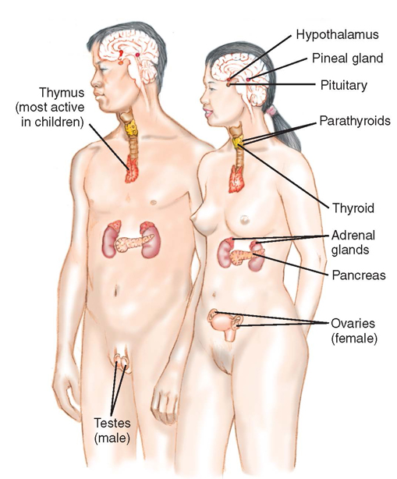
The Endocrine System: Anatomy and Physiology (2 of 2)
The brain controls the release of hormones.
Excesses or deficiencies in hormones can cause disease.
FIGURE 6-40 The endocrine system controls the
production and release of hormones in the body.
© Jones & Bartlett Learning.
Notes:
Lecture Outline
C. The brain controls the release of hormones.
1. This system uses primary and secondary feedback loops to keep the body in balance.
D. Excesses or deficiencies in hormones can cause disease processes, such as diabetes.

Slide 92
The Urinary System: Anatomy and Physiology (1 of 2)
Controls the discharge of certain waste materials filtered from the blood by the kidneys
Controls fluid balance in the body
Filters and eliminates wastes
Controls pH balance
Notes:
Lecture Outline
XVIII. The Urinary System: Anatomy and Physiology
A. The urinary system controls the discharge of certain waste materials filtered from the blood by the kidneys.
B. Main functions of the urinary system:
1. Control fluid balance in the body
2. Filter and eliminate wastes
3. Control pH balance

Slide 93
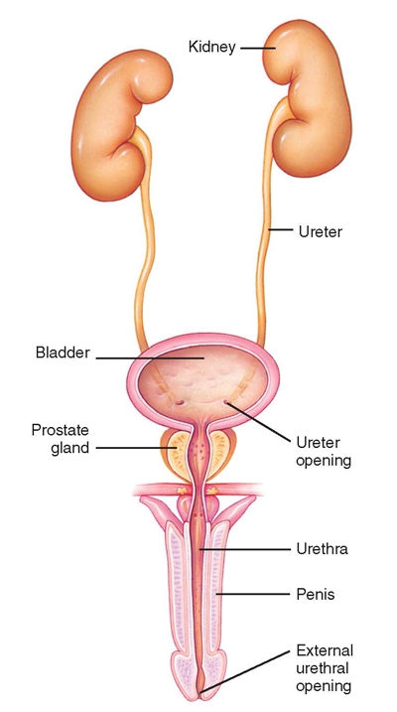
The Urinary System: Anatomy and Physiology (2 of 2)
Kidneys
Ureter
Urinary bladder
FIGURE 6-42 The urinary system lies in the
retroperitoneal (behind the peritoneum) space behind the
organs of the digestive system. The urinary system in men
and women includes the kidneys, ureters, bladder, and
urethra. This diagram shows the male urinary system.
© Jones & Bartlett Learning.
Notes:
Lecture Outline
C. The kidneys are two solid organs that lie in the retroperitoneal space.
1. Rid the blood of toxic waste products and control the balance of water and salt.
2. A ureter passes from each kidney to drain into the urinary bladder.
D. The urinary bladder is located immediately behind the pubic symphysis in the pelvic cavity.

Slide 94
The Genital System: Anatomy and Physiology (1 of 4)
Controls reproductive processes
Male system consists of:
  Testicles
  Epididymis
  Vasa deferentia
  Prostate gland
  Seminal vesicles
  Penis
Notes:
Lecture Outline
XIX. The Genital System: Anatomy and Physiology
A. The genital system controls the reproductive processes by which life is created.
B. The male reproductive system consists of the testicles, epididymis, vasa deferentia, prostate gland, seminal vesicles, and penis.
1. Lies outside the pelvic cavity (except for the prostate gland and seminal vesicles)

Slide 95
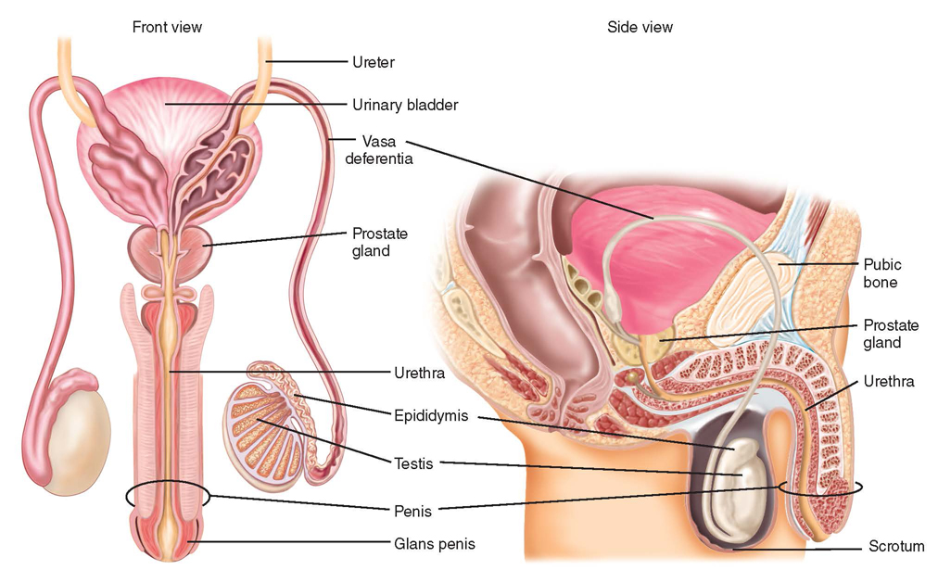
The Genital System: Anatomy and Physiology (2 of 4)
FIGURE 6-43 The male reproductive system consists of the testicles, epididymis, vasa deferentia, prostate gland, seminal vesicles, and penis.
© Jones & Bartlett Learning.
Notes:
This figure shows the organs of the male reproductive system.

Slide 96
The Genital System: Anatomy and Physiology (3 of 4)
Female system consists of:
  Ovaries
  Fallopian tubes
  Uterus
  Cervix
  Vagina
Notes:
Lecture Outline
C. The female reproductive system consists of the ovaries, fallopian tubes, uterus, cervix, and vagina.
1. Contained entirely within the pelvic cavity (except the clitoris and labia)

Slide 97
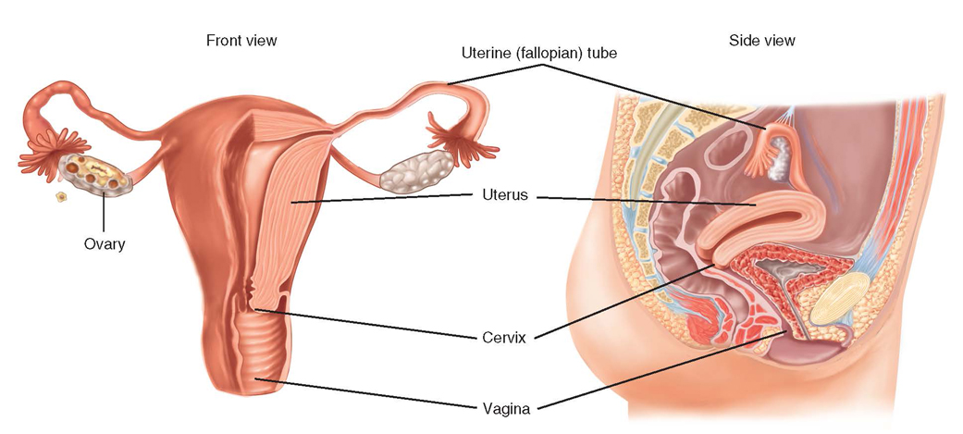
The Genital System: Anatomy and Physiology (4 of 4)
FIGURE 6-44 The female reproductive system consists of the ovaries, fallopian tubes, uterus, cervix, and vagina.
© Jones & Bartlett Learning.
Notes:
This figure shows the organs of the female reproductive system.

Slide 98
Life Support Chain (1 of 3)
All cells in body require oxygen, nutrients, and removal of waste.
The circulatory system is the carrier of these supplies and wastes.
If interference occurs, cells become damaged and die.
Notes:
Lecture Outline
XX. Life Support Chain
A. Cells are the foundation of the human body.
1. All cells in the body require oxygen, nutrients, and removal of waste.
2. The respiratory and circulatory systems are the carrier of these supplies and wastes.
3. If interference occurs, cells become damaged and die.

Slide 99
Life Support Chain (2 of 3)
Cells use oxygen to turn nutrients into chemical energy through metabolism.
Aerobic metabolism uses oxygen.
Cells switch to anaerobic metabolism when oxygen is limited.
Notes:
Lecture Outline
B. Cells use oxygen to take available nutrients and turn them into chemical energy through metabolism.
1. Adenosine triphosphate (ATP) is used in energy metabolism and storage.
2. Aerobic metabolism uses oxygen.
3. Cells switch to anaerobic metabolism when oxygen is limited.
a. Lactic acid is a damaging waste product of this process.
b. As lactic acid and other wastes accumulate around the cell, the area become toxic and cells can die.

Slide 100
Life Support Chain (3 of 3)
Movement of oxygen, waste, and nutrients occurs by diffusion.
pH is critical to diffusion.
The body expends a large amount of energy to maintain normal pH.
Notes:
Lecture Outline
4. Movement of oxygen, waste, and nutrients occurs by diffusion.

Slide 101
Pathophysiology (1 of 5)
The study of functional changes that occur when body reacts to disease
Respiratory compromise is the inability of the body to move gas effectively.
  Hypoxia
  Hypercarbia
Notes:
Lecture Outline
XXI. Pathophysiology
A. Pathophysiology is the study of functional changes that occur when the body reacts to disease.
B. Respiratory compromise is the inability of the body to move gas effectively
1. Can lead to:
a. Hypoxia: decreased level of oxygen in the body
b. Hypercarbia: elevated level of carbon dioxide in the body

Slide 102
Pathophysiology (2 of 5)
Factors that impair ventilation
  Blocked airway
  Impairment of the muscles of breathing
  Airway obstructed physiologically (asthma)
  Other factors
Notes:
Lecture Outline
2. Factors that impair ventilation:
a. Blocked airway
b. Impairment of the muscles of breathing
i. Neuromuscular disease
ii. Trauma
c. Airway is obstructed physiologically (eg, asthma attack)
d. Drug overdose, trauma to the chest wall, allergic reaction

Slide 103
Pathophysiology (3 of 5)
Factors that impair respiration
  Change in atmosphere
  High altitudes
  Impaired movement of the gas across cell membrane
Notes:
Lecture Outline
3. Factors that impair respiration:
a. Change in the atmosphere
b. High altitudes
c. Impaired movement of the gas across the cell membrane

Slide 104
Pathophysiology (4 of 5)
V/Q ratio
  How much gas is being moved effectively through the lungs
  How much blood is flowing around the alveoli where perfusion occurs
  Mismatch occurs when one variable is abnormal.
Notes:
Lecture Outline
C. Ventilation/perfusion mismatch
1. The V/Q ratio describes how much gas is being moved effectively through the lungs and how much blood is flowing around the alveoli.
2. A mismatch occurs when one of those two variables is abnormal.
a. Pulmonary embolism preventing blood flow
b. Edema inside of the alveoli
c. When either the “V” or the “Q” is impacted, respiratory compromise can occur.

Slide 105
Pathophysiology (5 of 5)
Effects of respiratory compromise on the body:
  Oxygen levels fall and carbon dioxide levels rise.
  Respiratory rate increases.
  Blood becomes more acidic.
  The brain sends commands to the body to breathe.
  Cells move from aerobic to anaerobic metabolism.
Notes:
Lecture Outline
D. Effects of respiratory compromise on the body:
1. Oxygen levels throughout the body fall and carbon dioxide levels rise.
2. The brain detects an increase in carbon dioxide levels.
3. The body increases its respiratory rate in an attempt to return the carbon dioxide levels to normal.
4. If increased respiratory does not occur or is not effective in returning the carbon dioxide levels to normal, the blood will become more acidic.
5. Blood oxygen levels will begin to fall. This will cause the brain to issue further commands to breathe.
6. Decreased oxygen levels will force cells to move from aerobic to anaerobic metabolism.

Slide 106
Shock (1 of 2)
Occurs when organs and tissue do not receive enough oxygen
  Impaired oxygen delivery causes cellular hypoxia.
Categorized into several types depending on the cause
Notes:
Lecture Outline
E. Shock
1. A condition in which organs and tissue receive an inadequate flow of blood and oxygen
2. Impaired oxygen delivery causes cellular hypoxia, which leads to anaerobic metabolism, lactic acid production, and organ dysfunction.
3. Shock is categorized into several types depending on the cause.

Slide 107
Shock (2 of 2)
Effects of shock on the body
  The level of oxygen supplied to the tissues falls.
  Cells engage in anaerobic metabolism.
  Severe metabolic acidosis ensues.
  Baroreceptors initiate the release of epinephrine and norepinephrine.
  The heart rate increases.
  Interstitial fluid moves into the capillaries.
Notes:
Lecture Outline
F. Effects of shock on the body
1. Similar to the effects of respiratory compromise
2. The level of oxygen supplied to the tissues falls.
3. Cells engage in anaerobic metabolism resulting in lactic acid production
4. Baroreceptors detect decreased blood pressure and initiate the release of epinephrine and norepinephrine.
5. The heart rate increases, the heart beats more forcefully, and blood vessels constrict.
6. Interstitial fluid moves into the capillaries.

Slide 108
Impairment of Cellular Metabolism
Results in the inability to properly use oxygen and glucose at the cellular level
Cells create energy through anaerobic metabolism.
  Can result in metabolic acidosis
Brain cells cannot use alternative fuels.
Cellular injury may become irreversible.
Notes:
Lecture Outline
G. When there is inadequate oxygen, cells will create energy through anaerobic metabolism.
a. Can result in metabolic acidosis
b. Requires more energy than when using glucose for fuel
c. Decreased ability of the blood to effectively carry oxygen to the cells
d. Decreased functioning of oxygen within the cell
e. Brain cells cannot use alternative fuels.
i. If the supply of available glucose is dramatically decreased, brain cells will quickly become damaged or die.
f. Cellular injury, up to a point, may be repairable if normal tissue perfusion is restored.
i. When irreversible injury occurs, no treatment will help.

Slide 109
Review
Which of the following are found in the retroperitoneal space?
  Liver
  Spleen
  Kidneys
  Stomach

Slide 110
Review
Answer: C
Rationale: The kidneys lie in the retroperitoneal space—the space behind the abdominal cavity. The spleen, liver, and stomach are all located within the anterior (true) abdomen.

Slide 111
Review
Which of the following are found in the retroperitoneal space?
  Liver
  Rationale: The liver lies immediately beneath the diaphragm in the anterior abdomen.
  Spleen
  Rationale: The spleen lies under the rib cage in the left upper quadrant of the abdominal cavity.
  Kidneys
  Rationale: Correct answer
  Stomach
  Rationale: The stomach lies in the left upper quadrant of the abdominal cavity.

Slide 112
Review
The cartilaginous tip of the sternum is called the:
  costal arch.
  manubrium.
  angle of Louis.
  xiphoid process.

Slide 113
Review
Answer: D
Rationale: The xiphoid process projects from the lower part of the sternum. It is made of cartilage and, relative to other parts of the sternum (eg, manubrium, angle of Louis), is soft to palpation.

Slide 114
Review
The cartilaginous tip of the sternum is called the:
  costal arch.
  Rationale: This is the bridge of cartilage that connects the ends of the 6th through 10th ribs to the lower sternum.
  manubrium.
  Rationale: This is the upper section of the sternum, one of three parts.
  angle of Louis.
  Rationale: This is found at the level where the second rib is attached to the sternum.
  xiphoid process.
  Rationale: Correct answer

Slide 115
Review
A person with bilateral femur fractures has:
  fractured one of his or her femurs.
  fractured both of his or her femurs.
  one femur fractured in two places.
  fractured the lateral aspect of the femur.

Slide 116
Review
Answer: B
Rationale: The term bilateral refers to both sides of the body with reference to the midline. Therefore, bilateral femur fractures would indicate that both femurs are fractured.

Slide 117
Review
A person with bilateral femur fractures has
  fractured one of his or her femurs.
  Rationale: Bilateral means two.
  fractured both of his or her femurs.
  Rationale: Correct answer
  one femur fractured in two places.
  Rationale: A bilateral fracture is one fracture that occurs in two bones.
  fractured the lateral aspect of the femur.
  Rationale: This means that the outside portion of the femur is broken.

Slide 118
Review
The MOST prominent landmark on the anterior surface of the neck is the:
  mastoid process.
  cricoid cartilage.
  thyroid cartilage.
  cricothyroid membrane.

Slide 119
Review
Answer: C
Rationale: The thyroid cartilage, commonly referred to as the “Adam’s apple,” is the most prominent landmark on the anterior (front) surface of the neck. The cricoid cartilage is located directly inferior to (below) the thyroid cartilage; it is a less prominent landmark.

Slide 120
Review
The MOST prominent landmark on the anterior surface of the neck is the:
  mastoid process.
  Rationale: This is the prominent bony mass at the base of the skull.
  cricoid cartilage.
  Rationale: This is the firm ridge of cartilage inferior to (below) the thyroid cartilage.
  thyroid cartilage.
  Rationale: Correct answer
  cricothyroid membrane.
  Rationale: This is the thin sheet of connective tissue that joins the thyroid cartilage and the cricoid cartilage.

Slide 121
Review
Insulin is produced in the:
  liver.
  pancreas.
  thyroid gland.
  adrenal glands.

Slide 122
Review
Answer: B
Rationale: The pancreas is a solid organ that produces both insulin and digestive juices. Insulin is produced in the islets of Langerhans, which are a part of the pancreas.

Slide 123
Review
Insulin is produced in the:
  liver.
  Rationale: The poisonous by-products of digestion are rendered harmless in the liver.
  pancreas.
  Rationale: Correct answer
  thyroid gland.
  Rationale: The thyroid, which is found in the neck over the larynx, regulates the body’s metabolism.
  adrenal glands.
  Rationale: These glands, which are located in the kidneys, regulate salt levels, sugar levels, and sexual function.

Slide 124
Review
_____ connect(s) muscles to bones.
  Ligaments
  Cartilage
  Tendons
  Joints

Slide 125
Review
Answer: C
Rationale: Tendons connect muscle to bone. Ligaments connect bone to bone. Cartilage is smooth connective tissue covering the ends of bones at mobile joints. Joints consist of the ends of the bones and the surrounding connecting and supporting tissues.
Notes:
This rationale is incorrect.

Slide 126
Review
_____ connect(s) muscles to bones.
  Ligaments
  Rationale: Connect bone to bone.
  Cartilage
  Rationale: Covers the ends of bones at joints.
  Tendons
  Rationale: Correct answer
  Joints
  Rationale: Occur where two long bones come in contact.

Slide 127
Review
The normal resting adult heart rate is:
  50 to 70 beats/min.
  60 to 100 beats/min.
  80 to 110 beats/min.
  110 to 120 beats/min.

Slide 128
Review
Answer: B
Rationale: The normal resting heart rate for an adult is 60 to 100 beats/min. Bradycardia exists when the adult heart rate is less than
60 beats/min, and tachycardia exists when it is greater than 100 beats/min.

Slide 129
Review
The normal resting adult heart rate is:
  50 to 70 beats/min.
  Rationale: Less than 60 beats/min is bradycardia.
  60 to 100 beats/min.
  Rationale: Correct answer
  80 to 110 beats/min.
  Rationale: Normal is more than 100 beats/min.
  110 to 120 beats/min.
  Rationale: More than 100 beats/min is tachycardia.

Slide 130
Review
The left atrium of the heart receives ___________ blood from the ___________.
  oxygenated; lungs
  deoxygenated; body
  oxygenated; body
  deoxygenated; lungs

Slide 131
Review
Answer: A
Rationale: The left atrium receives oxygenated blood from the lungs via the pulmonary veins. The right atrium receives deoxygenated blood from the body via the venae cavae.

Slide 132
Review
The left atrium of the heart receives ___________ blood from the ___________.
  oxygenated; lungs
  Rationale: Correct answer
  deoxygenated; body
  Rationale: The right atrium of the heart receives deoxygenated blood from the body.
  oxygenated; body
  Rationale: No part of the heart receives oxygenated blood from the body. It receives oxygenated blood only from the lungs.
  deoxygenated; lungs
  Rationale: The right atrium and right ventricle are the only parts of the heart that receive deoxygenated blood from the body.

Slide 133
Review
The largest part of the brain is the:
  cerebrum.
  brainstem.
  cerebellum.
  foramen magnum.

Slide 134
Review
Answer: A
Rationale: The three major parts of the brain are the cerebrum, the brainstem, and the cerebellum. The largest part of the brain is the cerebrum, which is sometimes called the “gray matter.” The cerebellum—sometimes called the “athlete’s brain”—is the smallest part of the brain. The brainstem is responsible for vital functions such as heart rate, breathing, and blood pressure. The foramen magnum is the large opening at the base of the skull through which the spinal cord passes.

Slide 135
Review
The largest part of the brain is the:
  cerebrum.
  Rationale: Correct answer
  brainstem.
  Rationale: The bottom portion of the brain is responsible for vital functions, heart rate, breathing, and blood pressure.
  cerebellum.
  Rationale: The cerebellum is the smallest part of brain. It is sometimes called the athlete’s brain.
  foramen magnum.
  Rationale: The spinal cord passes through this large opening at the base of the skull.

Slide 136
Review
Which of the following statements about red blood cells is FALSE?
  They contain iron.
  They carry oxygen.
  They help to fight infection.
  They give color to the blood.

Slide 137
Review
Answer: C
Rationale: The hemoglobin molecules in red blood cells contain iron, give color to the blood, and carry oxygen. White blood cells play a role in helping the body to fight infection.

Slide 138
Review
Which of the following statements about red blood cells is FALSE?
  They contain iron.
  Rationale: True; hemoglobin found in red blood cells carries iron.
  They carry oxygen.
  Rationale: True; hemoglobin found in red blood cells carries oxygen.
  They help to fight infection.
  Rationale: Correct answer
  They give color to the blood.
  Rationale: True; hemoglobin found in red blood cells gives blood color.

